Slide 1
Each vs All

Slide 2
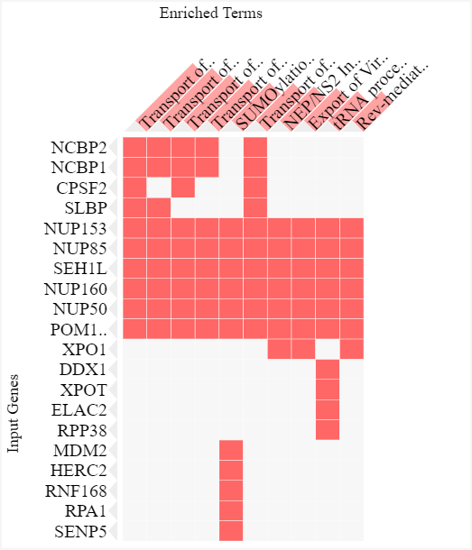
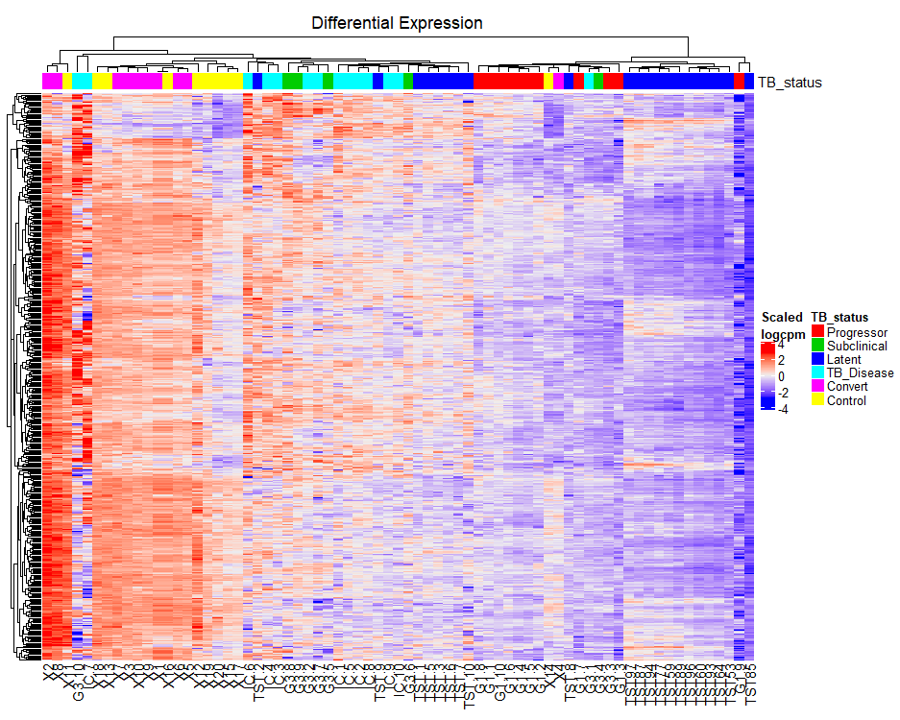
Control

Slide 3
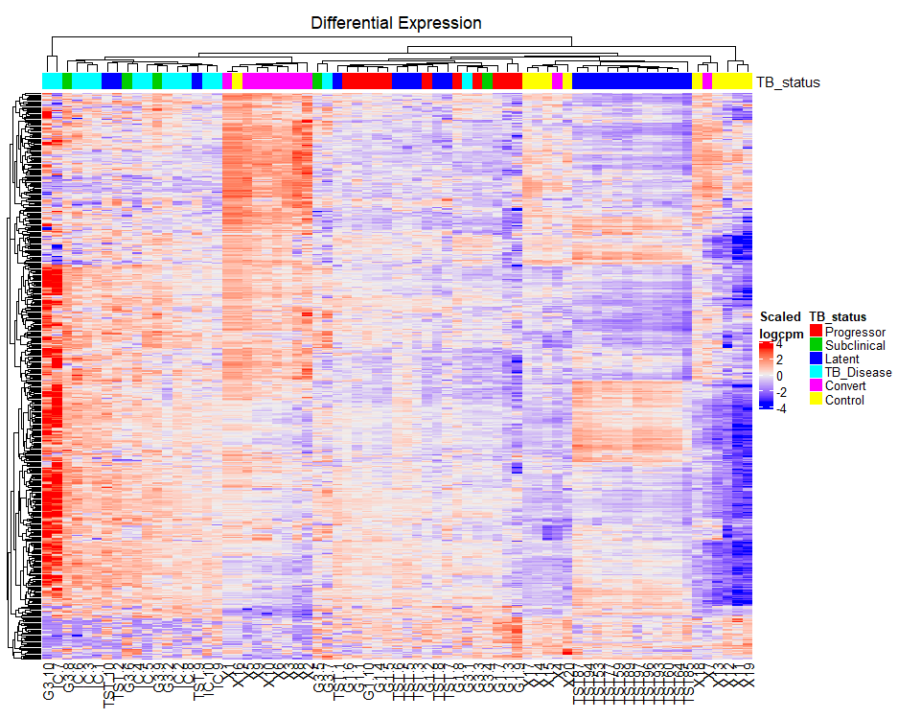
Converter
No significant differences between Converters and other groups

Slide 4
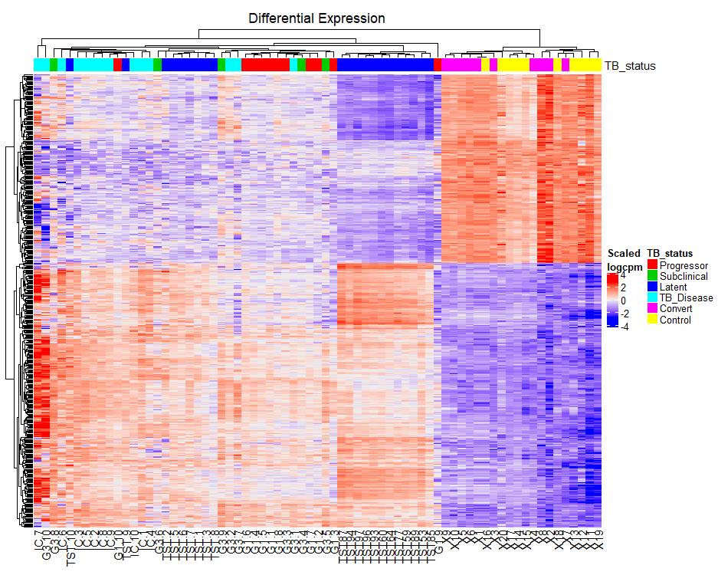
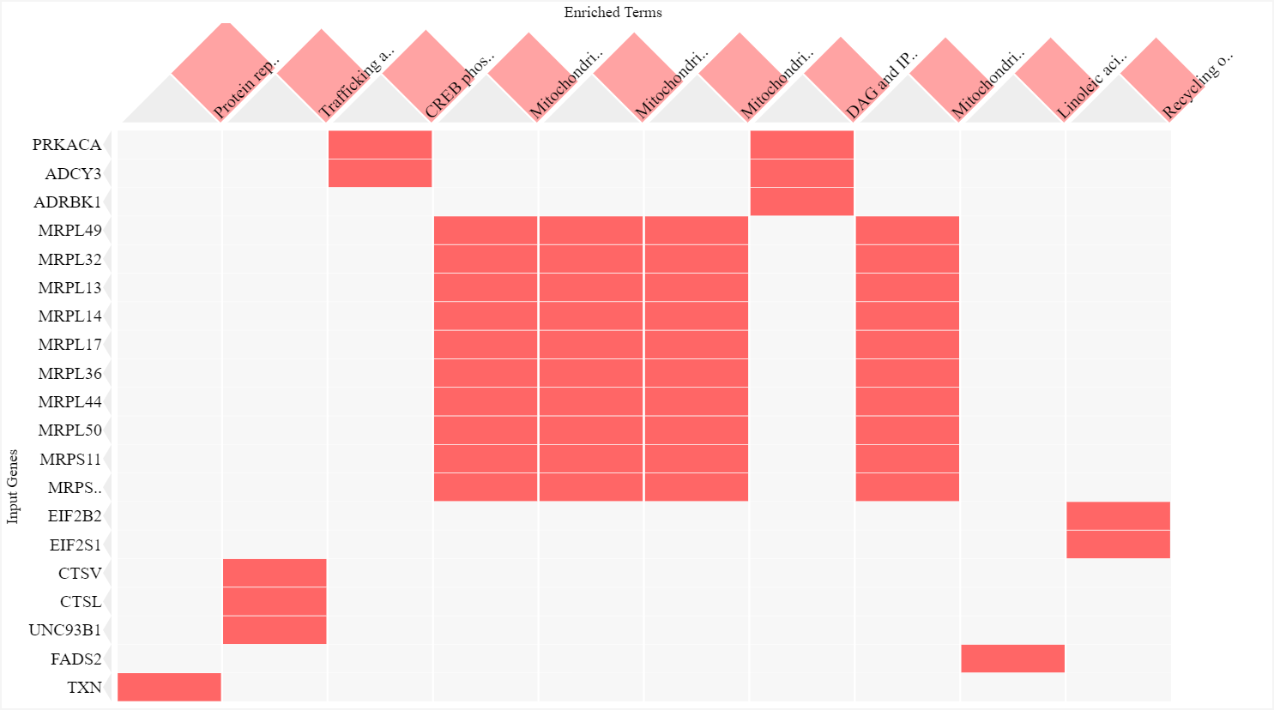
Latent

Slide 5
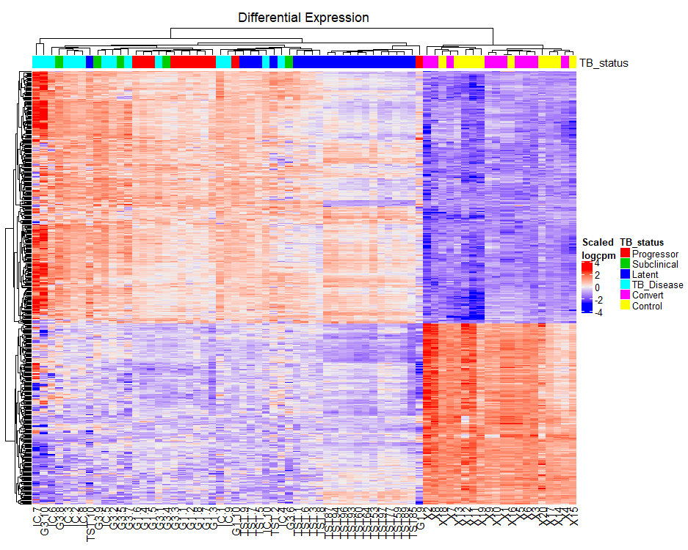
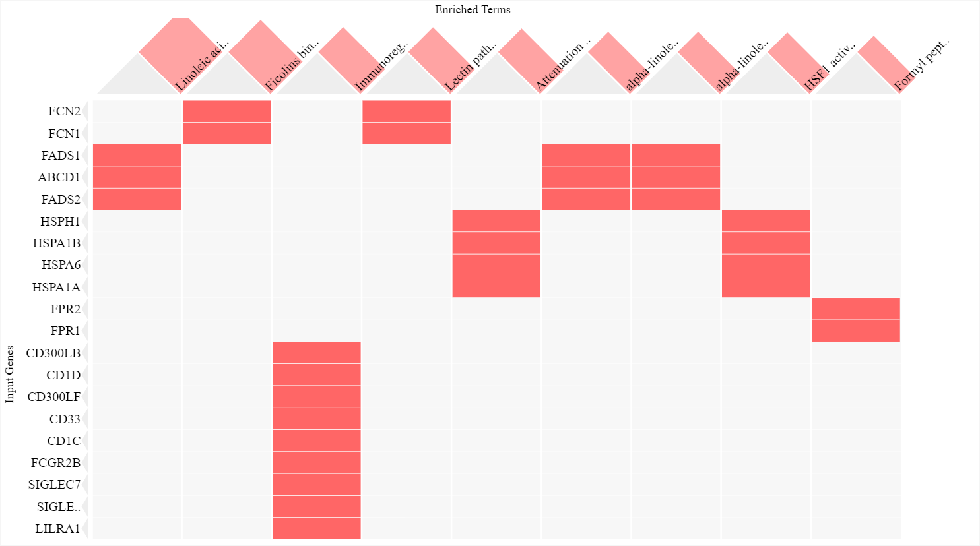
Progressor

Slide 6
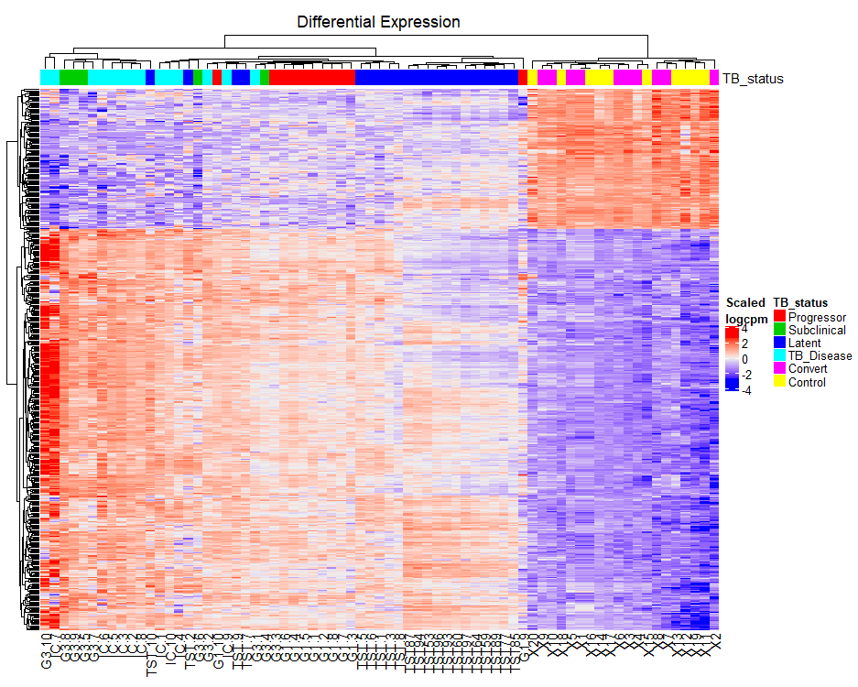
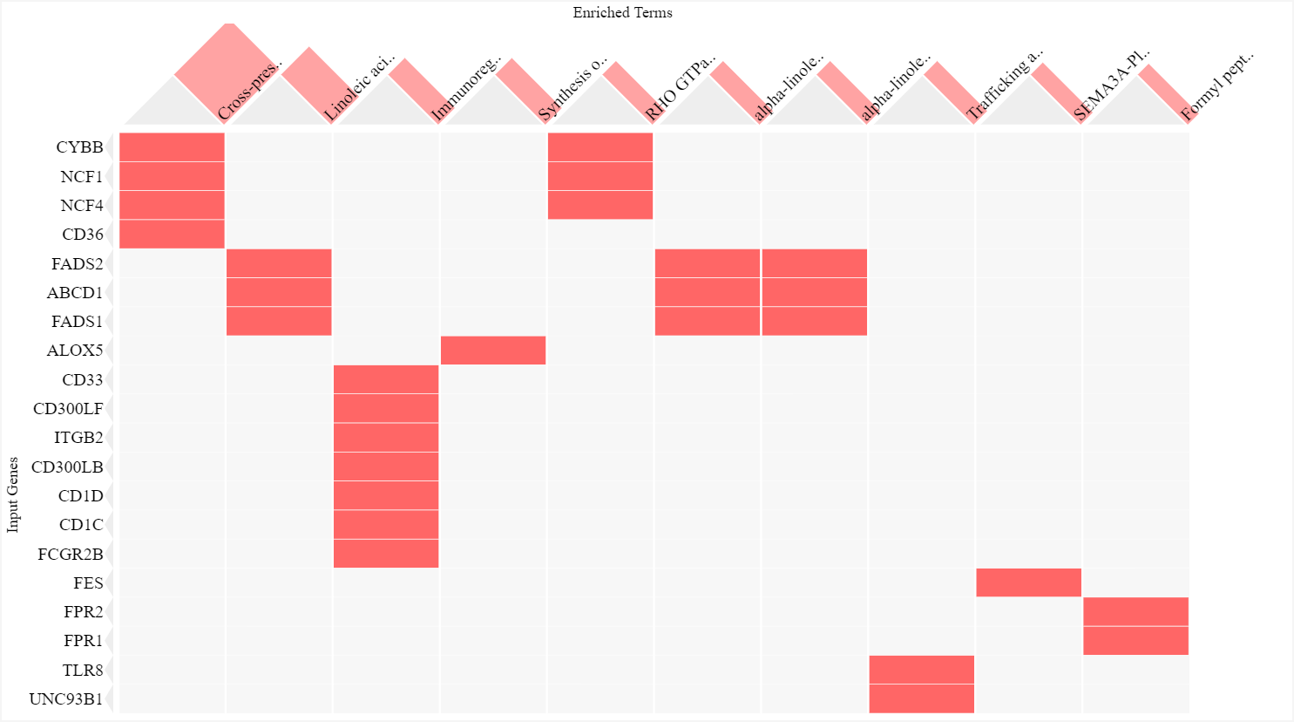
Subclinical
https://amp.pharm.mssm.edu/clustergrammer/Enrichr_new/5e0f9579016cd2303eb0c05c?preview=false&col_order=rank&row_order=clust&N_row_sum=20

Slide 7
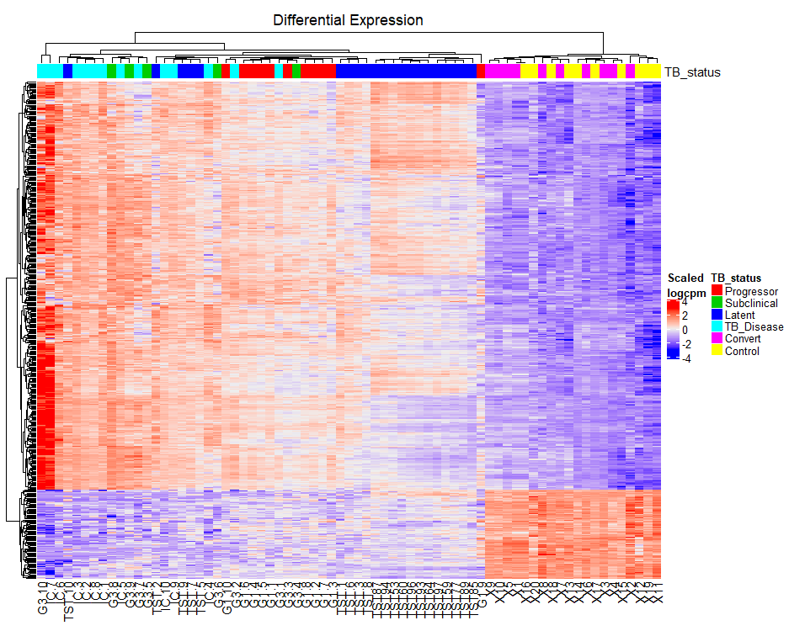
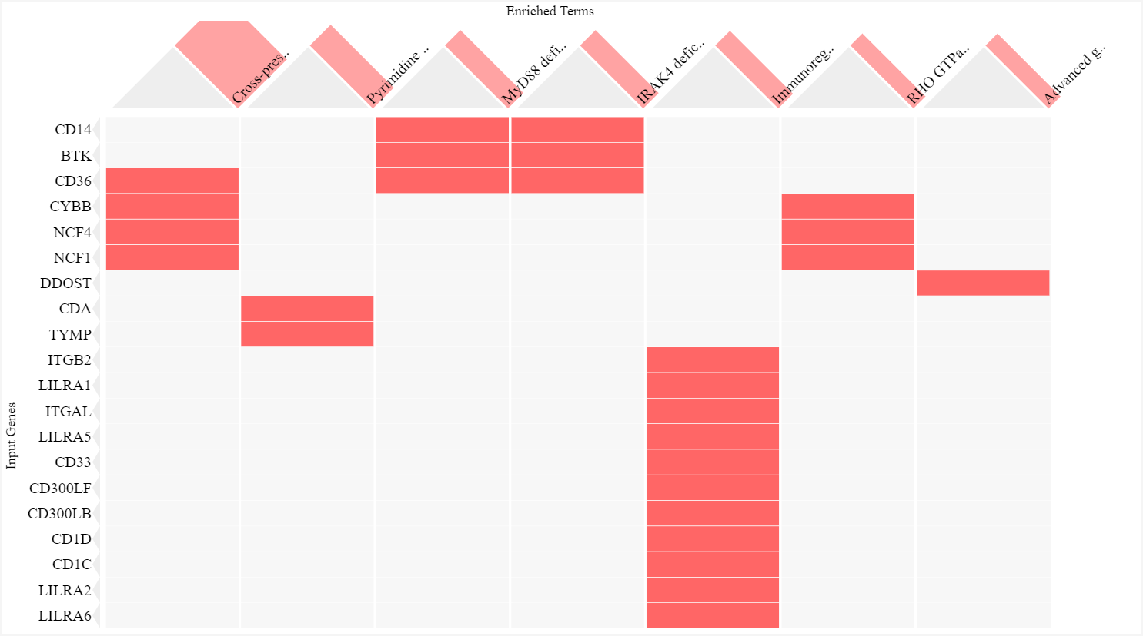
TB_Disease
https://amp.pharm.mssm.edu/clustergrammer/Enrichr_new/5e0f96cc016cd2303eb0c06d?preview=false&col_order=rank&row_order=clust&N_row_sum=20

